Slide 1
update – irma restoration projects
As of June 14, there are only three ceilings in the 03 stack left to remove. We continue to hold to the new 8 week span time per stack that resulted from the presence of the fiberglass underlayment and will finish the 03 stack by June 28.
We use Dow Allguard paint and sealant on the exterior walls of our building. Dow temporarily closed their manufacturing plant without notice. Allguard will be unavailable until the plant reopens in August.
There are no alternative paints/sealers that are as good or that will allow us to preserve the 10 year warranty we already have on the areas of the building painted with Dow Allguard.
We used the last of the Allguard that we had on hand to paint the areas surrounding the 03 windows that still have hurricane shutters. Those shutters will be reinstalled on June 18.
The unpainted areas that remain on the North wall are approximately 80% as waterproof as they would be if they were fully painted. They will remain this way until the Dow Allguard becomes available. We’ve had no reported leaks from the heavy rains last week.
The balcony ceilings and walls require a different type of paint that is available, so all balcony stucco and painting work will proceed unaffected. As soon as Dow Allguard becomes available, balcony painting will be interrupted and the painters will immediately be redirected to finish the North wall of the 03 stack.
05 unit owners need to have everything removed from their balconies before June 24 to prepare for balcony painting.
04 unit owners need to have everything removed from their balconies before July 22 to prepare for balcony painting.

Slide 2
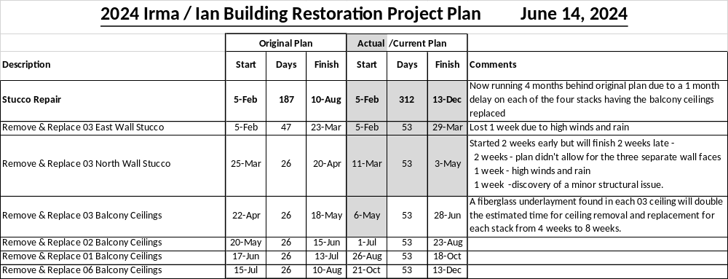
update – irma restoration projects
Stucco Removal / repair
The association will open your hurricane shutters to allow balcony access for ceiling removal and repair and will re-close them upon completion.
It is your responsibility to have everything removed from your balcony before ceiling removal of your balcony stack begins. Balconies will be reopened starting on the top floor and moving down as the ceiling removal and repair on each floor is completed. Once the ceiling your balcony is completed and the masking is removed, you may replace your belongings. Although your balcony will be closed for ceiling work for anywhere between 3-25 days, your balcony windows will only be masked for 3-5 of those days

Slide 3
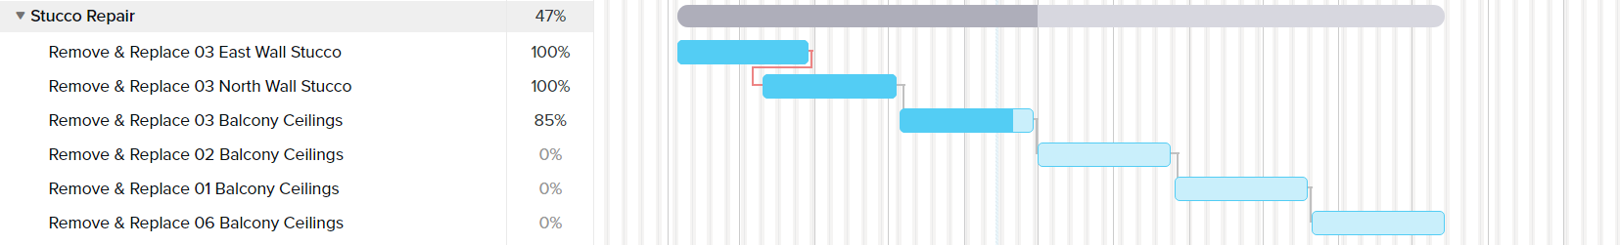
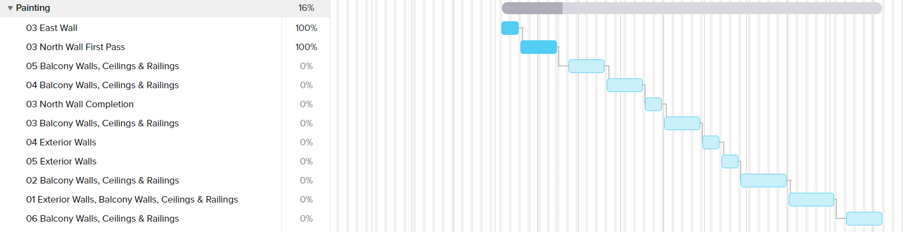
update – irma restoration projects

Slide 4
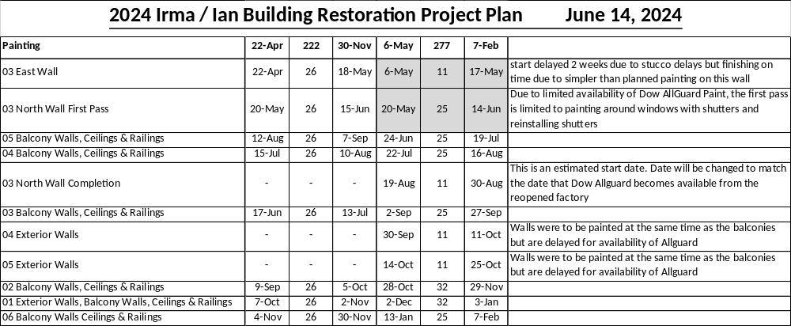
update – irma restoration projects
PAINTing
Painting of the north wall of the 03 stack was split into two tasks. The task for completion will begin as soon as Allguard paint/sealer is available.
The association will open your balcony hurricane shutters to allow for balcony access and painting and will re-close them upon completion.
It is your responsibility to have everything removed from your balcony before painting of your balcony stack begins. Balconies will be reopened starting on the top floor and moving down as the painting on each floor is completed. Once the painting of your balcony is completed and the masking is removed, you may replace your belongings. Although your balcony will be closed for painting for anywhere between 1-25 days, your balcony windows will only be masked off for 1-2 of those days.

Slide 5
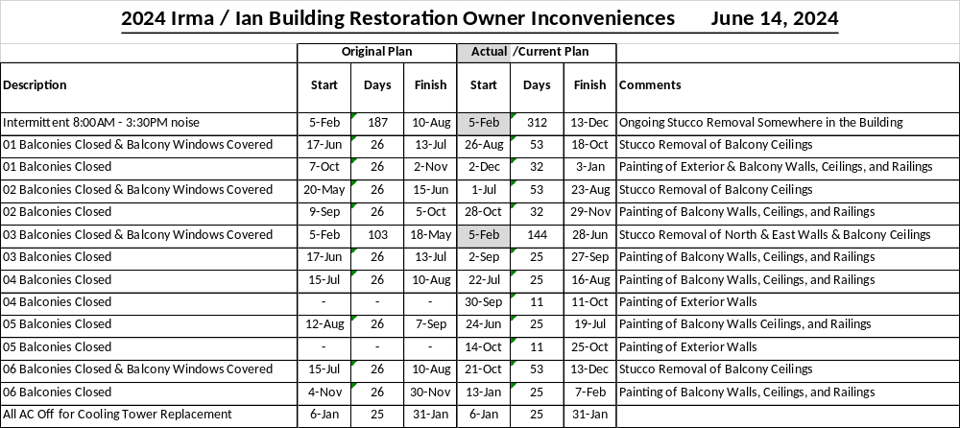
update – irma restoration projects
OWNER INCONVENIENCES

